Slide 1
Coordination Chemistry-II (part: 1)
Dr. Semanti Basu
Assistant Professor
Department of Chemistry
Bejoy Narayan Mahavidyalaya,
Itachuna, Hooghly, W. B., India

Slide 2
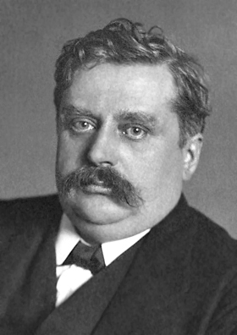
coordination Chemistry
Alfred Werner
Swiss Chemist
Father of Coordination Chemistry Nobel prize 1913

Slide 3
Bonding in coordination compounds
Valence Bond Theory (VBT)
Crystal Field Theory (CFT)
Modified CFT, known as Ligand Field Theory (LFT)
Molecular Orbital Theory (MOT)

Slide 4
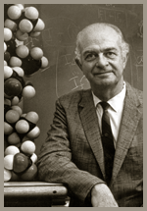
Valance Bond Theory
Basic Principle
A covalent bond forms when the orbitals of two atom overlap and are occupied by a pair of electrons that have the highest probability of being located between the nuclei.
Linus Carl Pauling (1901-1994)
The Nobel Prize in Chemistry for 1954 and the Peace Prize for 1962 for his research into the nature of the chemical bond and its application to the elucidation of the structure of complex substances.”

Slide 5
Valence bond Theory
This theory was proposed by Heitler and London in the year 1927 on the basis of the wave mechanics of electrons and it was further extended by Pauling and Slater in the year 1931. According to this theory, a covalent bond is formed between two atoms by the overlap of half-filled valence atomic orbitals of each atom containing one unpaired electron. In VBT the interactions among the various valence shell electrons are considered when the combining species approach close together from infinity. The equilibrium distance is attended when the potential energy drops to a minimum value. This theory accounts for the directional nature of covalent bonds.

Slide 6
Postulates of Valence bond Theory
A covalent bond is formed only when half-filled orbitals of two atoms overlap each other.
Each overlapping atomic orbital should contain an unpaired electron with an opposite spin.
The overlapping atomic orbitals must have nearly the same i.e. comparable energies.
The electron spins are neutralized and electrons get paired up on overlapping of atomic orbitals.
During the overlap of atomic orbitals, the electron density increases in between the two nuclei and therefore repulsion between the two nuclei of bonded atoms decreases. This results in the liberation of energy and an increase in the attractive forces between atoms.
A bond is formed at an equilibrium distance when the system has minimum potential energy and maximum stability.

Slide 7
Postulates of Valence bond Theory
The strength of a covalent bond depends upon the extent of overlap of orbitals between the two atoms. Greater the extent of overlap between atomic orbitals more is the energy released and stronger is the bond formed.
The number of covalent bonds formed by an atom of an element is equal to the number of unpaired electrons present in the valence shell of the atom.
Each atomic orbital (except-s-orbital) has a particular direction in space. Hence covalent bonds formed by the overlap of atomic orbitals possess directional characteristics.
The geometry of a molecule is decided by the directional orientation of overlapping orbitals, s orbital is spherically symmetrical and overlaps in any direction. But p, d, and f orbitals have particular directions in space, hence the geometry and bond angle depends upon the orientation of overlapping orbitals. To minimize electronic repulsion and to have maximum symmetry the orbitals orient in such a way that they are far apart from each other.

Slide 8
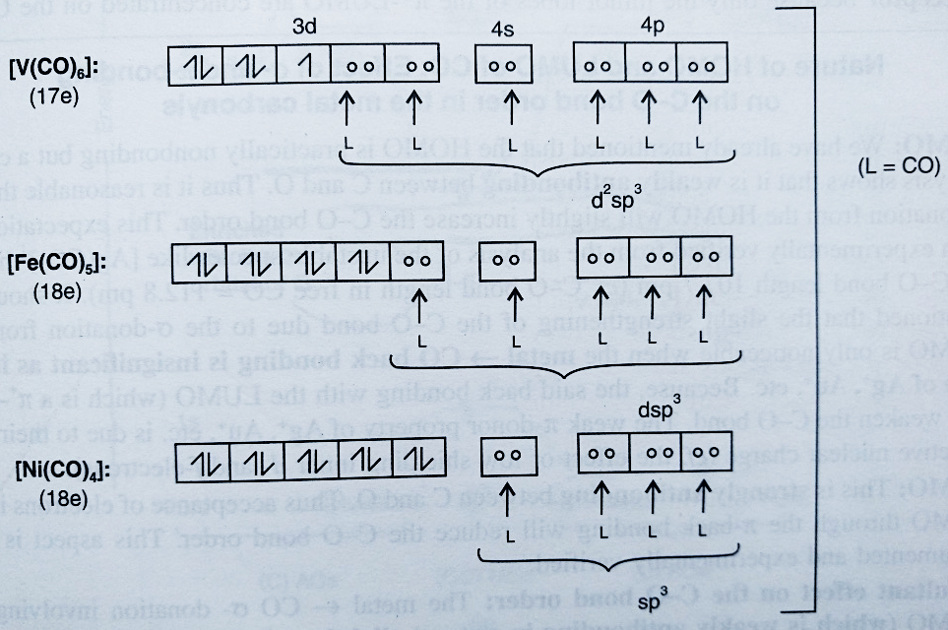
Bonding of mononuclear carbonyls-VBT treatment

Slide 9
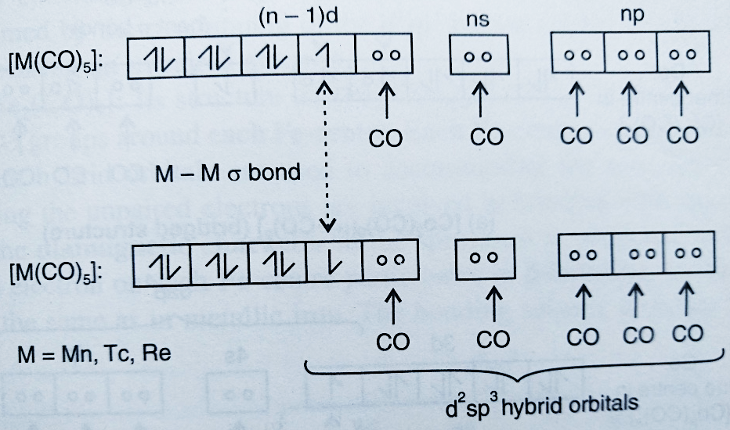
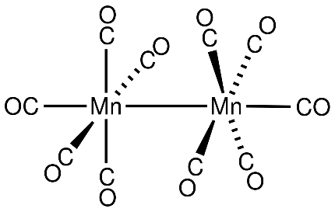
Bonding of di-nuclear carbonyls-VBT treatment

Slide 10
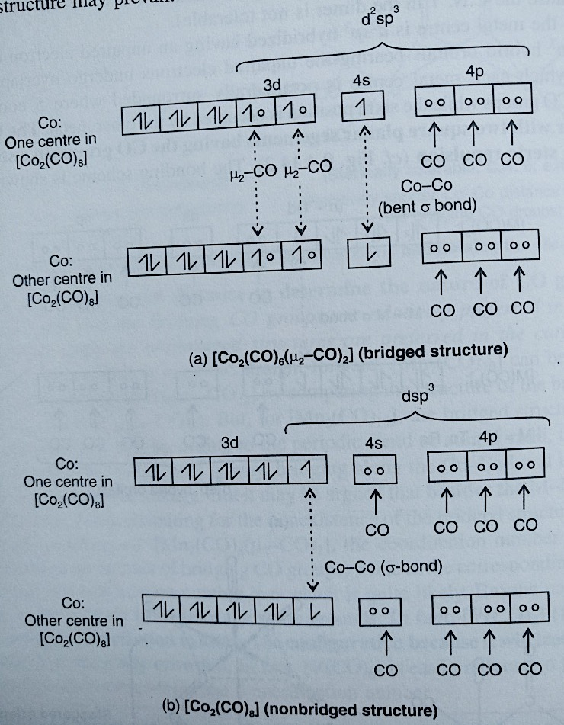
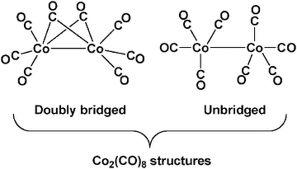
Bonding of di-nuclear carbonyls-VBT treatment

Slide 11
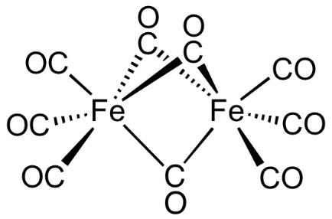
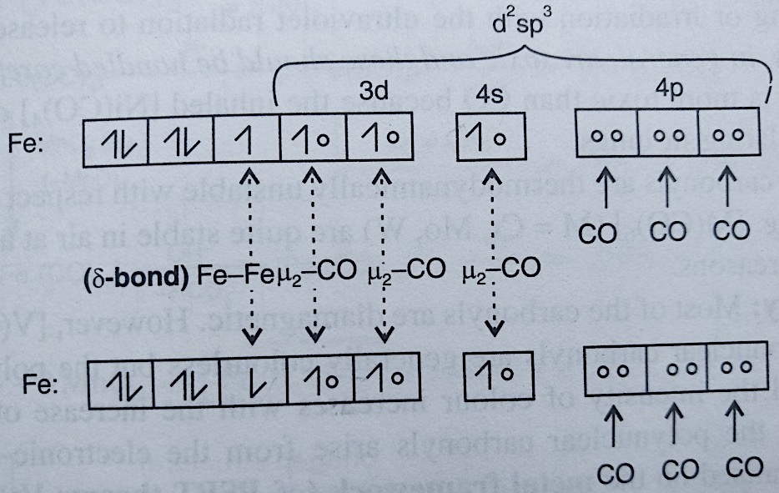
Bonding of di-nuclear carbonyls-VBT treatment

Slide 12
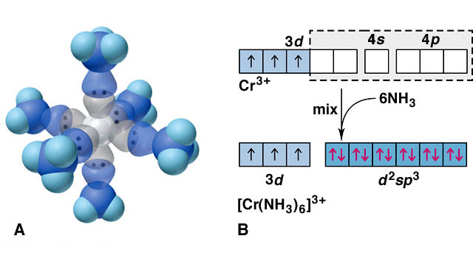
Valance Bond Model
Ligand = Lewis base
Metal = Lewis acid
s, p and d orbitals give hybrid orbitals with specific geometries
Number and type of M-L hybrid orbitals determines geometry of the complex
Octahedral Complex
e.g. [Cr(NH₃)₆]³⁺

Slide 13
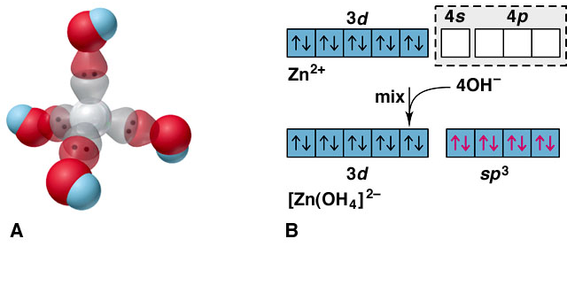
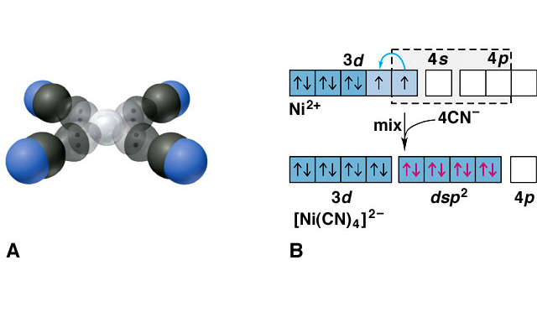
Tetrahedral e.g. [Zn(OH)₄]²⁻
Square Planar e.g. [Ni(CN)₄]²⁻
Limitations of VB theory
Cannot account for colour of complexes
May predict magnetism wrongly
Cannot account for spectrochemical series

Slide 14
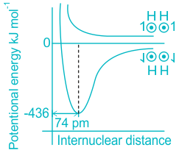
Valence bond Theory
Potential Energy Diagram, Formation of H2 molecule

Slide 15
Potential Energy Diagram, Formation of H2 molecule
When the two hydrogen atoms are separated by a large distance, those two atoms can neither attract nor repel each other. The potential energy of the two hydrogen atoms is arbitrarily taken to be zero.
As the two hydrogen atoms containing electrons with opposite spins approach each other, attractive forces, as well as repulsive forces, operate, attractive forces being stronger than repulsive ones, the potential energy decreases.
An equilibrium inter-nuclear distance is the one, where attractive forces are balanced by repulsive forces and the potential energy of the system attains a minimum value.
At this stage, the maximum overlap of atomic orbitals takes place and a stable bond is formed. The inter-nuclear distance is 74 pm, which is the H-H bond length. The energy liberated is 436 kJ/mol.; which is known as bond energy.
If the distance between the two atoms is decreased further, repulsive forces exceed the attractive forces and the potential energy of the system shoots up.
If the atoms containing electrons with parallel spins approach each other, the potential energy of the two hydrogen atoms goes on increasing, and bond formation does not take place.

Slide 16
Application of Valence bond Theory
The applications of valence bond theory is noticeable as it able to change the visualization of chemists. Few major applications are given below:
Valence bond theory opens up a new avenue to explain the root of covalent bond formation. This theory says that the covalent bond is a result of mixing of two atomic orbitals which is further change the concept of sharing electrons mentioned in ancient chemistry literatures.
The nature of covalent bond is transparently explained through the concept of valence bond theory. According to the theory the sustainability of the covalent bond is indeed dependent on the nature of overlapping.
The formation of HF molecule is described by the valence bond theory in which the mixing of hydrogen 1s and 2p orbital of fluorine generates the H-F bond.

Slide 17
Importance of Valence bond Theory Valence bond theory introduced five new concepts in chemical bonding 1. Delocalization of electrons over the two nuclei. 2. Shielding effect of electrons. 3. The essential covalent character of bond. 4. The presence of partial ionic nature in a covalent bond. 5. The concept of resonance and connection between resonance energy and molecular stability

Slide 18
The Conclusions Drawn from VBT
1. The covalent bond (2c-2e) is formed due to the pairing of two unpaired electrons with the opposite spins. The number of unpaired electrons gives the maximum possible number of covalent linkage. If the combining species do not have any unpaired electron, then before to participate in the bond formation the paired electrons must be unpaired. The paired electron pair can itself participate in bond formation as in coordinate covalent bond.
2. The exchange energy contributes significantly in stabilising a covalent bond. This quantum mechanical phenomenon can be rationalised from the principle of the model, particle in a box.
3. The covalent-ionic resonance is also important even in the homonuclear diatomic molecules. This factor becomes more important in the case of heteronuclear diatomic molecules where the electronegativity of the combining species differs significantly.

Slide 19
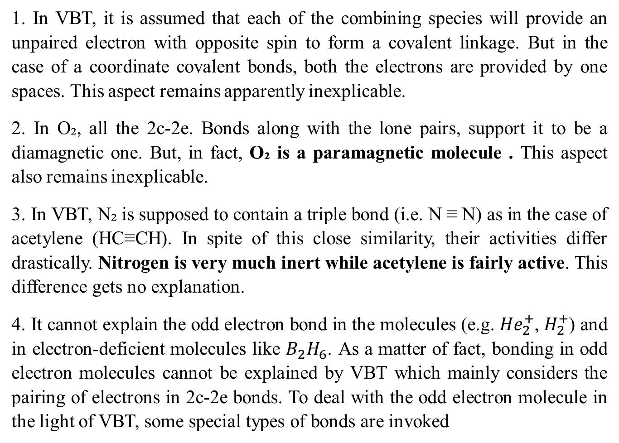
The Major Drawbacks in VBT
1. In VBT, it is assumed that each of the combining species will provide an unpaired electron with opposite spin to form a covalent linkage. But in the case of a coordinate covalent bonds, both the electrons are provided by one spaces. This aspect remains apparently inexplicable.
2. In O₂, all the 2c-2e. Bonds along with the lone pairs, support it to be a diamagnetic one. But, in fact, O₂ is a paramagnetic molecule . This aspect also remains inexplicable.
3. In VBT, N₂ is supposed to contain a triple bond (i.e. N ≡ N) as in the case of acetylene (HC≡CH). In spite of this close similarity, their activities differ drastically. Nitrogen is very much inert while acetylene is fairly active. This difference gets no explanation.
4. It cannot explain the odd electron bond in the molecules (e.g. ${He}_{2}^{+}$, $H_{2}^{+}$) and in electron-deficient molecules like $B_{2}H_{6}$. As a matter of fact, bonding in odd electron molecules cannot be explained by VBT which mainly considers the pairing of electrons in 2c-2e bonds. To deal with the odd electron molecule in the light of VBT, some special types of bonds are invoked

Slide 20
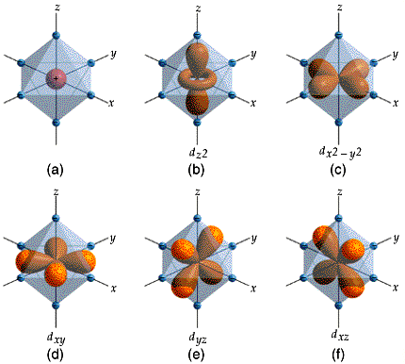
Crystal Field Theory
400
500
600
800
The relationship between colors and complex metal ions

Slide 21
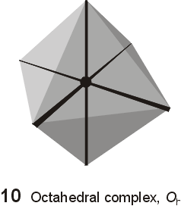
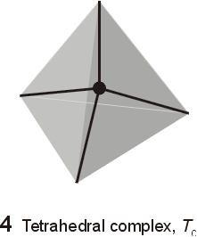
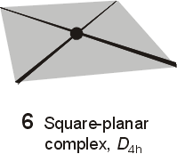
Crystal Field Model
A purely ionic model for transition metal complexes.
Ligands are considered as point charge.
Predicts the pattern of splitting of d-orbitals.
Used to rationalize spectroscopic and magnetic properties.

Slide 22
Crystal Field Theory
The Crystal Field Theory (CFT) was first proposed by Bethe (in 1929) by considering the electro-static interaction between the metal and the ligands to explain the colour and magnetic properties of the crystalline solids of metal salts. It was further modified by Van Vleck (in 1935) to account for the magnetic properties of transition metal complexes. However, before 1950, the theory was mainly con-fined in solid state physics. However, in 1950's, the theory was popularized by many workers (L.E. Orgel was one of pioneers) in understanding the problems of coordination chemistry.
The original crystal field theory (CFT) was modified in the adjusted crystal field theory (ACFT) or the ligand field theory (LFT) through the incorporation of some metal-ligand orbital overlap. How- ever, the basic approach of the electrostatic model of CFT is retained in LFT. In fact, in a practical sense, we do not make any difference between CFT and LFT. LFT may be considered to bridge between the crude CFT and more sophisticated MOT (molecular orbital theory).
CFT was first introduced to explain the properties of crystalline substances. This is why the theory was named so.

Slide 23
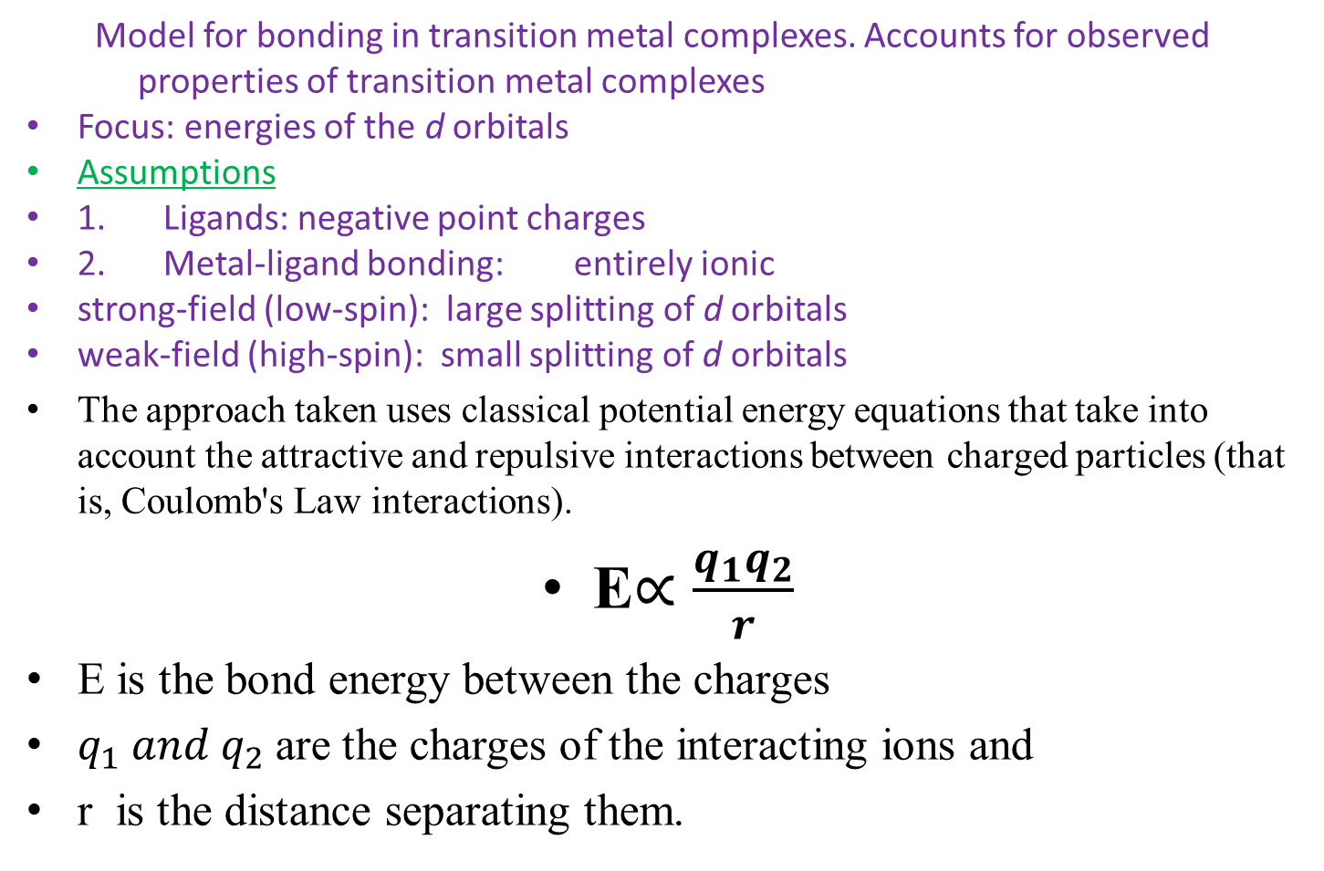
Crystal Field Theory & its basic platform

Slide 24
Crystal Field Theory
Electrostatic Interactions
(+) metal ion attracted to (-) ligands (anion or dipole)
provides stability
lone pair electrons on ligands repulsed by electrons in metal d orbitals
interaction called crystal field
influences d orbital energies of metal
not all d orbitals influenced the same way

Slide 25
The Postulates of CFT
The crystal field theory considers that the metal ion is situated in an electric field caused by the surrounding ligands.
The attraction between the central metal and the ligand in a complex is purely electrostatic. The negative end of the dipole of the neutral molecule ligand is directed towards the metal ion.
The transition metal or ion is considered as a positive ion of charge equal to the oxidation state.
The transition metal atom or ion is surrounded by a definite number of ligands, it may be negative ion or neutral molecules having lone pairs of electrons.
The ligands are considered as point charges and produce an electric field. This electric field changes the energy of the orbitals on the metal atom or ions.

Slide 26
The Postulates of CFT
6. Due to the repulsive force between the central metal ion and ligand, the electrons on the metal ion occupy the dd-orbitals as far as possible from the direction of approach of the ligand.
There is no interaction between the metal orbital and ligand orbitals.
In an isolated metal atom or ion, all the orbitals have the same energy, i.e., all five d orbitals (dxy, dxz, dyz, dx2–y2 and dz2) are degenerate.
9. If the central metal atom or ion is surrounded by the spherical symmetrical field of negative charges, the dd-orbitals remain degenerate. However, the energy of the orbitals is raised due to the repulsion between the field and the electron on the metal atom or ion. 10. In most transition metal complexes, the dd-orbitals are affected differently, and their degeneracy gets lost due to the field produced by the unsymmetrical ligand.

Slide 27
Basic Features of CFT & LFT
1. Ligands as the point-like charges: In the CFT model, the approaching ligands are considered as the point-like negative charges (that may be the negative charge on the ligand or the negative end of the ligand dipole).
2. Wave mechanical identity of the atomic orbitals of the metal centre: Though the ligands are considered as the point-like negative charges, the metal electrons are supposed to maintain their wave mechanical identity. In other words, the metal centre is supposed to bear the appropriate atomic orbitals to interact with the electrostatic field provided by the point-like negative charges, i.e. the ligands.
3. Electrostatic perturbation of the metal orbital electrons by the ligands: The metal-ligand interactions are basically electrostatic and these may be of ion-ion or ion-dipole type. For the transition metal complexes, the electrostatic effect of the ligands on the energies of the d-orbitals, i.e. d-electrons, is the most important aspect of CFT. The intensity and symmetry of the electrostatic field of the ligands (considered as the point-like charges) are important to interact with the atomic orbital of metal.

Slide 28
Basic Features of CFT & LFT
4. No covalent interaction: In true CFT, no covalent interaction between the ligand and metal is considered. It is due to the fact that the ligands are treated as the point like charges and their orbitals are of no consideration. Thus, in this concept, the metal electrons are considered as d nonbonding electrons. However, in the modified CFT described as LFT, the metal-ligand overlap is considered to some extent.
5. Effect on the energy and degeneracy of the metal orbitals: The question of degeneracy of the metal orbitals in the presence of the ligands depends the symmetry of electrostatic field of the ligands. The extent of energy change of the metal orbitals depends on the intensity of the electrostatic field of the ligands.

Slide 29
Effect of the Electrostatic Field of the Ligands on the Energies of the Metal Orbitals
(A) Effect on the metal s-orbital: The s-orbital is spherically symmetrical and consequently thisorbital is equally affected by the electrostatic field of the ligands in all directions. Thus, in thepresence of the electrostatic field of the ligands, energy of the s-orbital is simply changed.
(B) Effect of the spherical electrostatic field of the ligands: When the electrostatic field is spherically symmetrical, the metal p, d or f-sets of orbitals are simply changed in energy but the degeneracy in each set of the orbitals is retained as in the case of free metal ions (i.e. in the absence of any external field). Thus, the three p-orbitals or five d-orbitals or seven f-orbitals remain degenerate in the presence of a spherically symmetrical ligand field. Only their energies are affected depend ing on the intensity of the field.

Slide 30
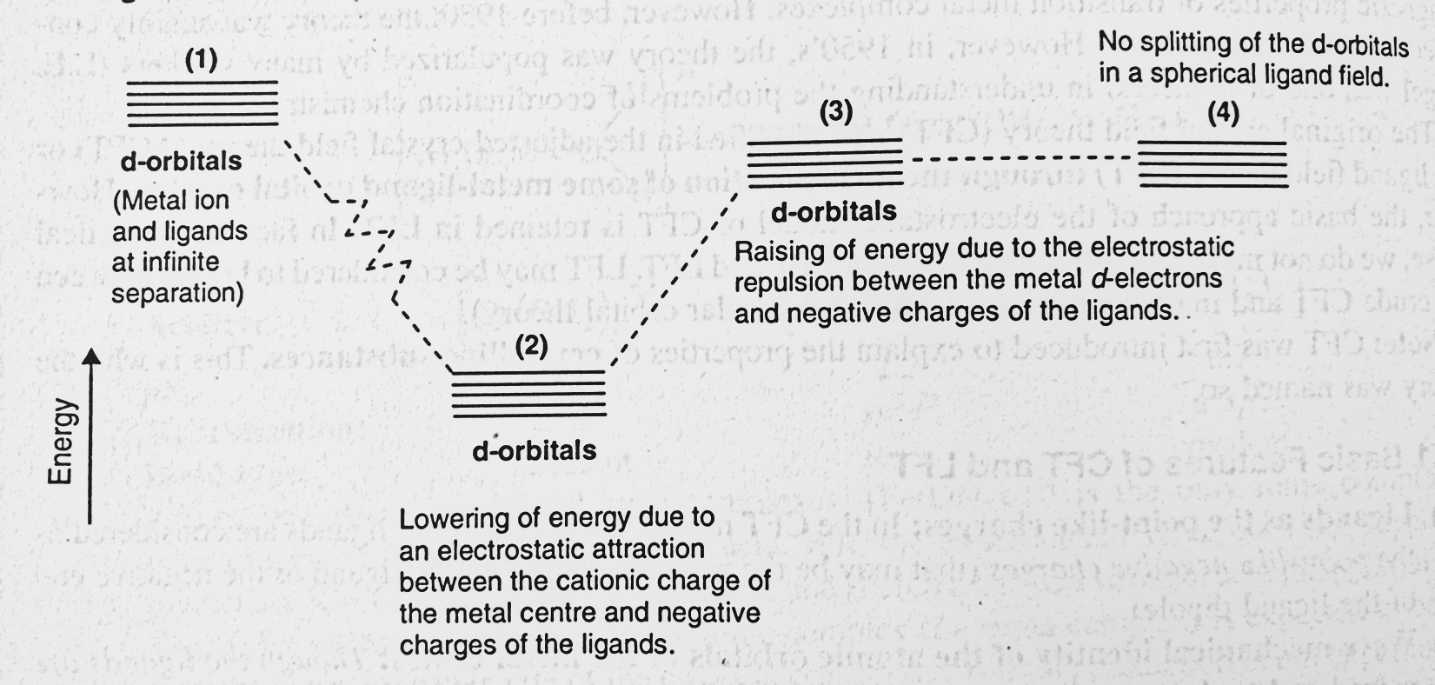
(B) Effect of the spherical electrostatic field of the ligands

Slide 31
Effect of the Electrostatic Field of the Ligands on the Energies of the Metal Orbitals
(C) Effect of the unsymmetrical electrostatic field of the ligands: Because of the directional char- aster of the p, d or f sets of the orbitals, they are no longer degenerate in the presence of an unsymmetrical field of the ligands. The nature of loss of degeneracy of the metal orbitals depends on both the symmetry of the ligand field and symmetry of the orbitals (in a particular set) experiencing the ligand field. Generally for the transition metals, the (n-1)p and (n-1)d orbitals are affected by the ligand field. But the (n-1)p orbitals are generally fully occupied and consequently they will not have any net effect the energy of the system through their splitting. Splitting of the (n-1)d orbitals (which generally remain partially filled in) is quite important. For the lanthanides, (n-2)f, i.e. the 4f orbitals are deeply seated, i.e. well shielded by the outer electrons. Consequently, the electrostatic field of the ligands on 4f orbitals is not important.

Slide 32
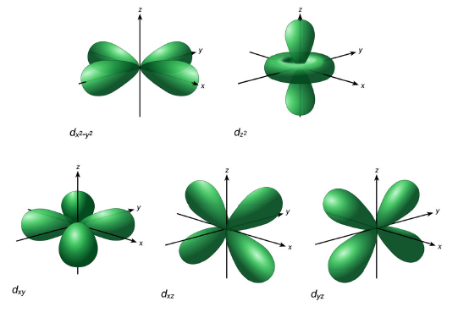
d-orbitals: look attentively along the axis
Linear combination of
d_{z}²-d_{x}² and d_{z}²-d_{y}²
d_{2z}²-_{x}²-_{y}²

Slide 33
Reference
Ashim K Das & Mahua Das, Fundamental Concept of Inorganic Chemistry, CBC Publishers & Distributors, Volume 2, First Edition, 2000
Ashim K Das, Fundamental Concept of Inorganic Chemistry, CBC Publishers & Distributors, Volume 4, Second Edition, 2014

Slide 34
Thank you

